Slide 1
SKYTRAX AIRLINE REVIEW ANALYSIS

Slide 2
RECAP
British Airways (BA) is the flag carrier airline of the United Kingdom (UK). Every day, thousands of BA flights arrive to and depart from the UK, carrying customers across the world
British Airways is interested in scraping and collecting customer feedback and analysing the collected data to present any useful insights.

Slide 3
PROCESS
Web scraping
Data Cleaning
Data Modeling
w Data Analysis
1
2
3
4
5
Uncover Insights

Slide 4
INSIGHTS
Sentiment
3795
REVIEWS
55%
Positive
Reviews
41%
Negative
Reviews
4%
Neutral
Reviews

Slide 5
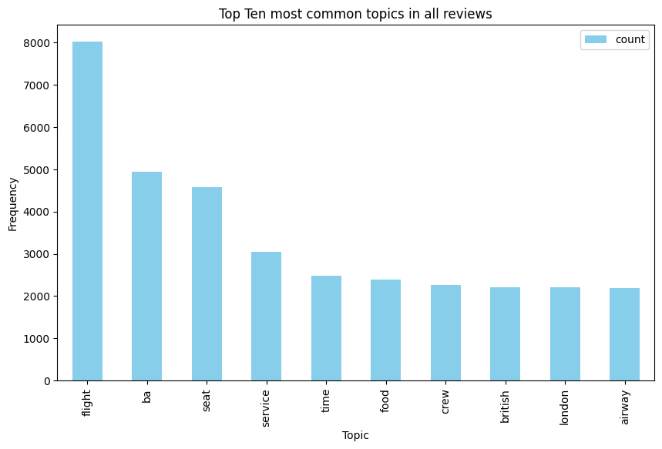

Slide 6
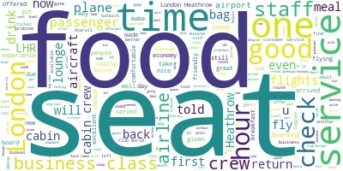
Most Common Topic Words

Slide 7
SUMMARY
Analysis:
The most common topics in reviews include seat, service, time, food and crew
Most common words in topics are seat, food, time and service
Insights:
Out of 3795 reviews, 55% were positive, 41% negative and 4% were neutral
Next Steps
This analysis can further be put into use to develop ML model to predict customer sentiment

Slide 8
THANK YOU

